Slide 1
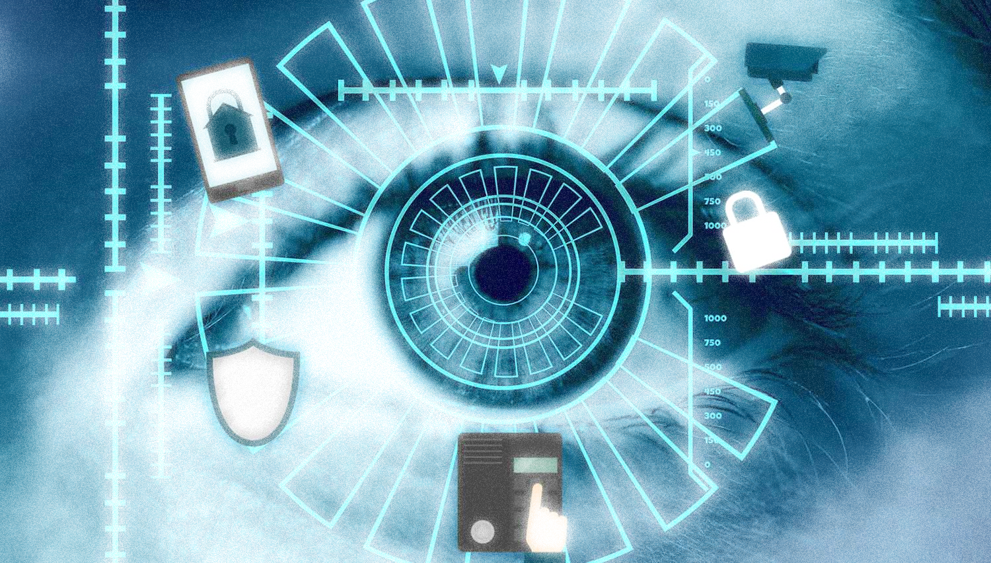
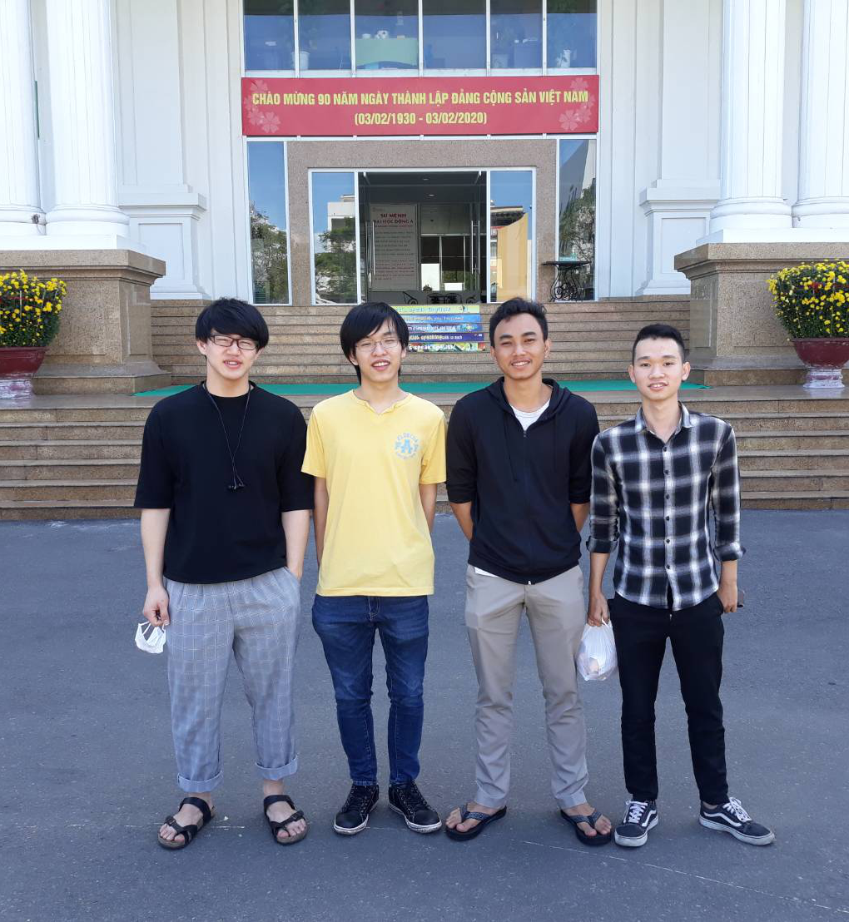
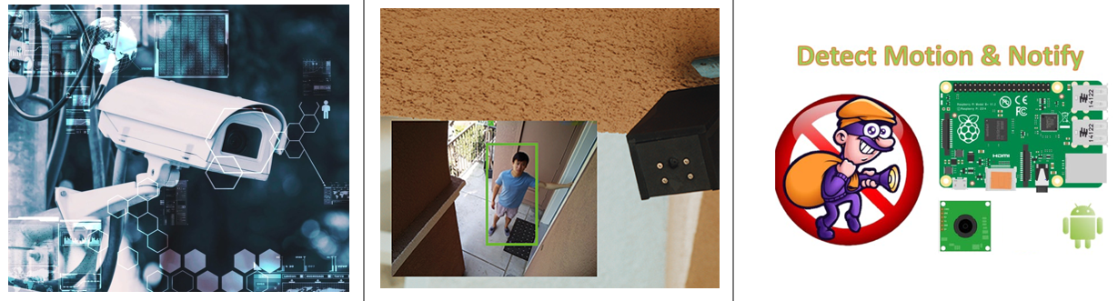
Raspberry Pi As Smart Security Camera (Keeping an eye on things)
Team Member:
Haryanto (Taiwan)
Nakanishi Toshiki (Japan)
Katayama Riki (Japan)
Phan Cong Nghia (Vietnam)
© group3-gPBL-2020

Slide 2

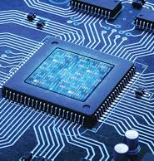
Outline
Idea of the system
Block diagram system
Android part
The feature and function
Video demo
Where you can find this project
Embedded system

Slide 3
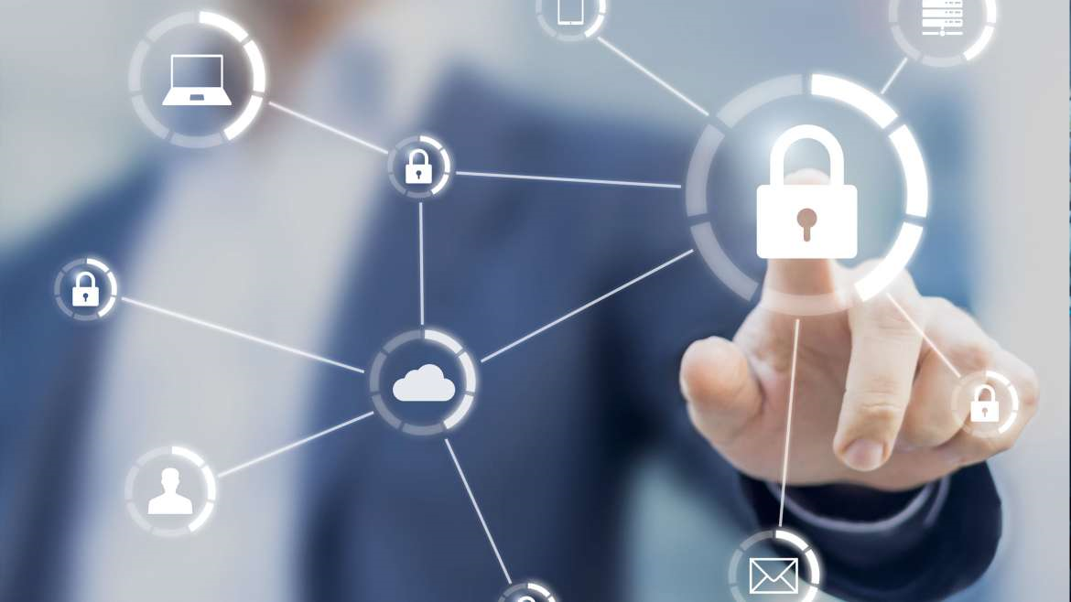
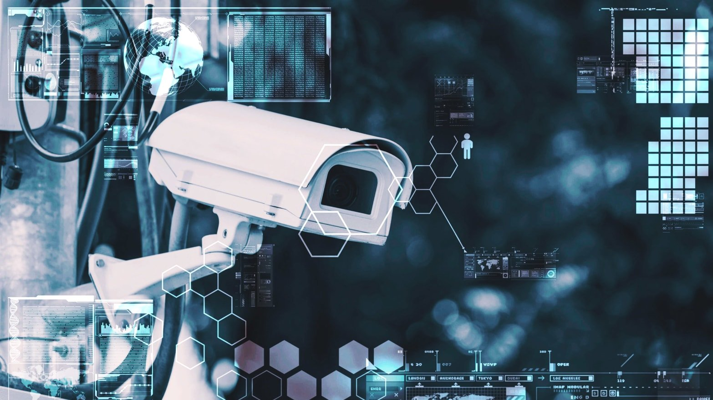
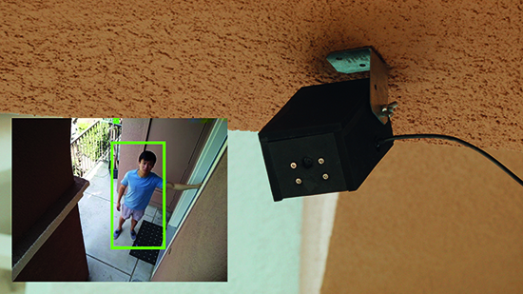
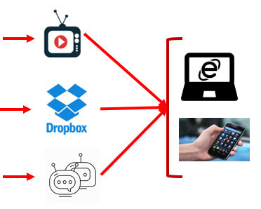
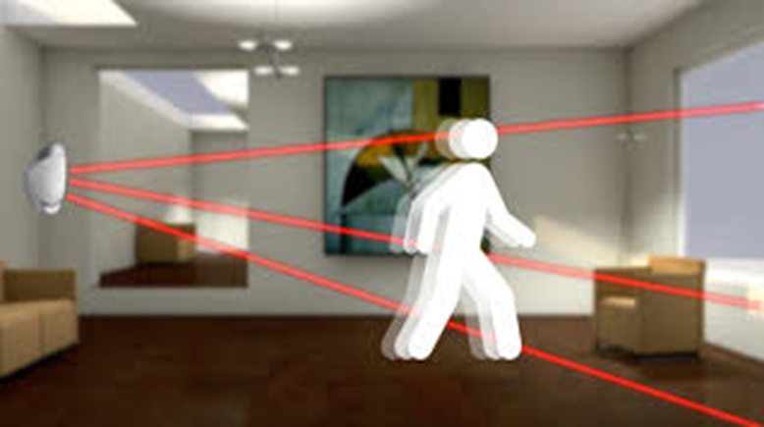
The Idea
Surveillance camera
Object detection sensor
Upload picture to cloud and notify to user
© group3-gPBL-2020

Slide 4
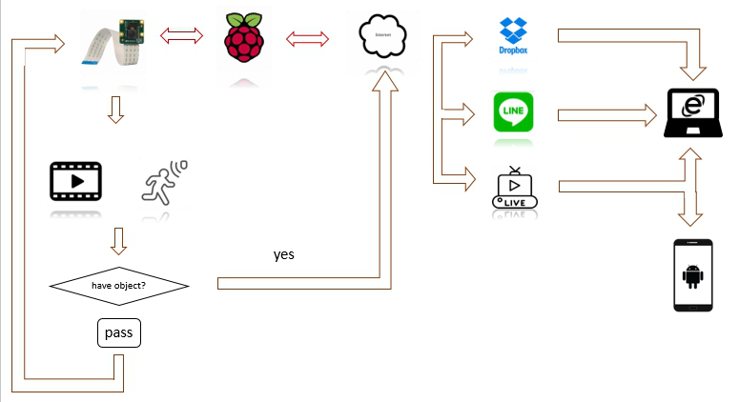
Block Diagram
© group3-gPBL-2020

Slide 5

Embedded System
Flask Server
Motion Detector
Notification
Upload to cloud storage (Dropbox)
© group3-gPBL-2020

Slide 6


Flask server
Embedded system
Flask called a micro framework because it does not require particular tools or libraries. It has no database abstraction layer, form validation, or any other components.
However, Flask supports extensions that can add application features as if they were implemented in Flask itself
© group3-gPBL-2020

Slide 7
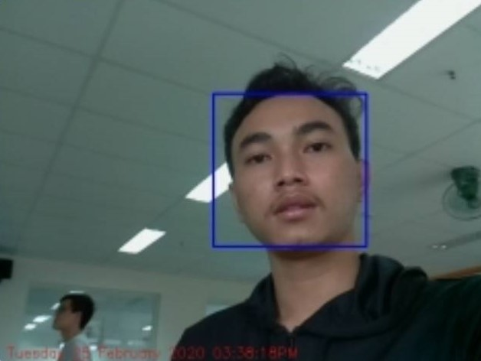
Motion Detector
Embedded system
Detect the motion
Take a photo
© group3-gPBL-2020

Slide 8
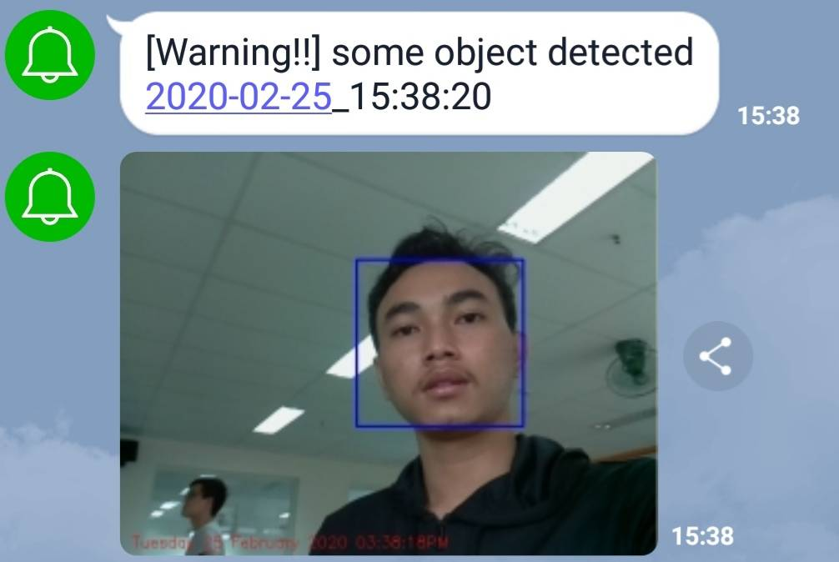
Notification
Embedded system
© group3-gPBL-2020

Slide 9
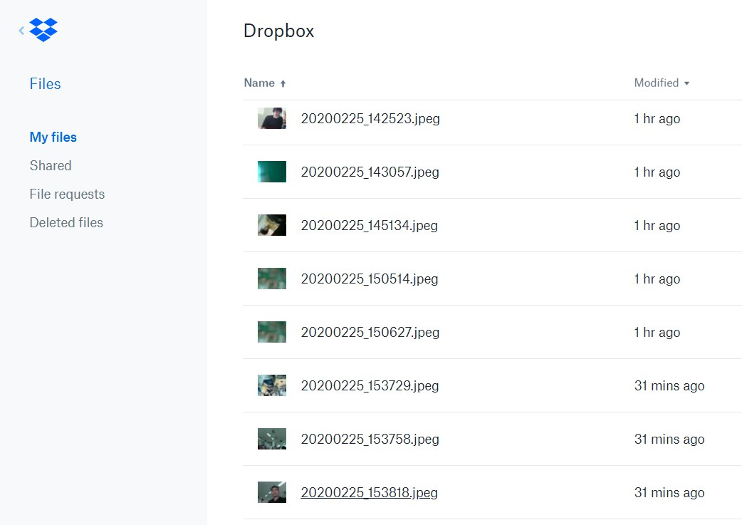

Upload to Cloud storage
Embedded system
© group3-gPBL-2020

Slide 10

Android part

Slide 11
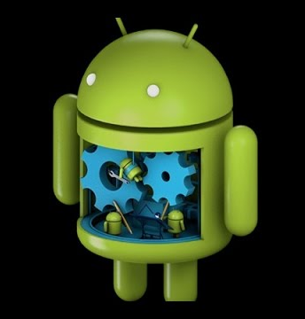
Introduction of Application
Open the application and login
Main screen have two feature, open cloud or live streaming
Click open cloud, you will get into storage cloud drobox
When click live streaming, you will be able to access camera live from raspberry
© group3-gPBL-2020

Slide 12
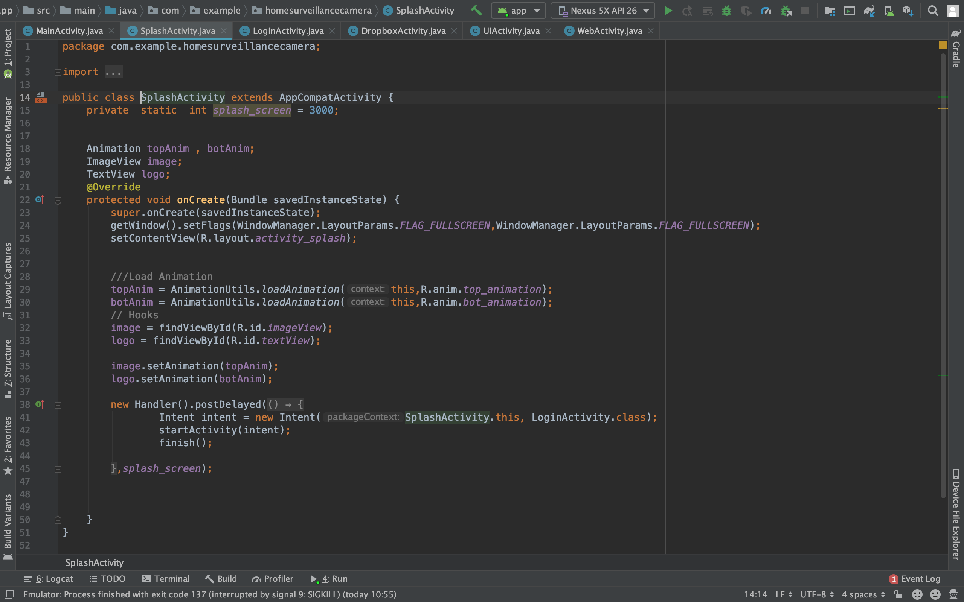
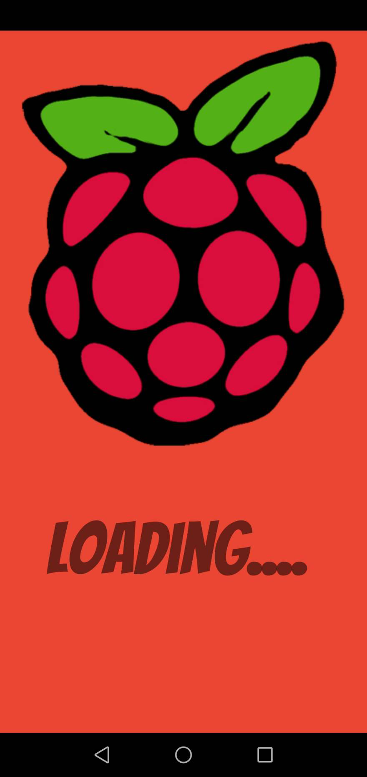
Welcome Screen
Introduction Android
© group3-gPBL-2020

Slide 13
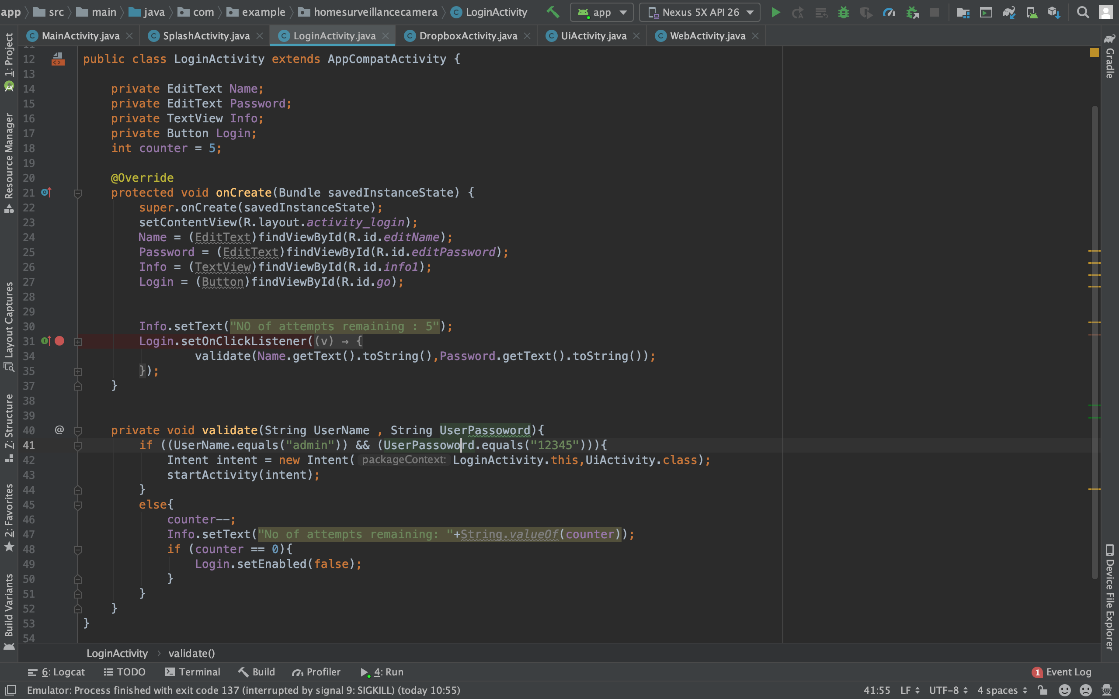
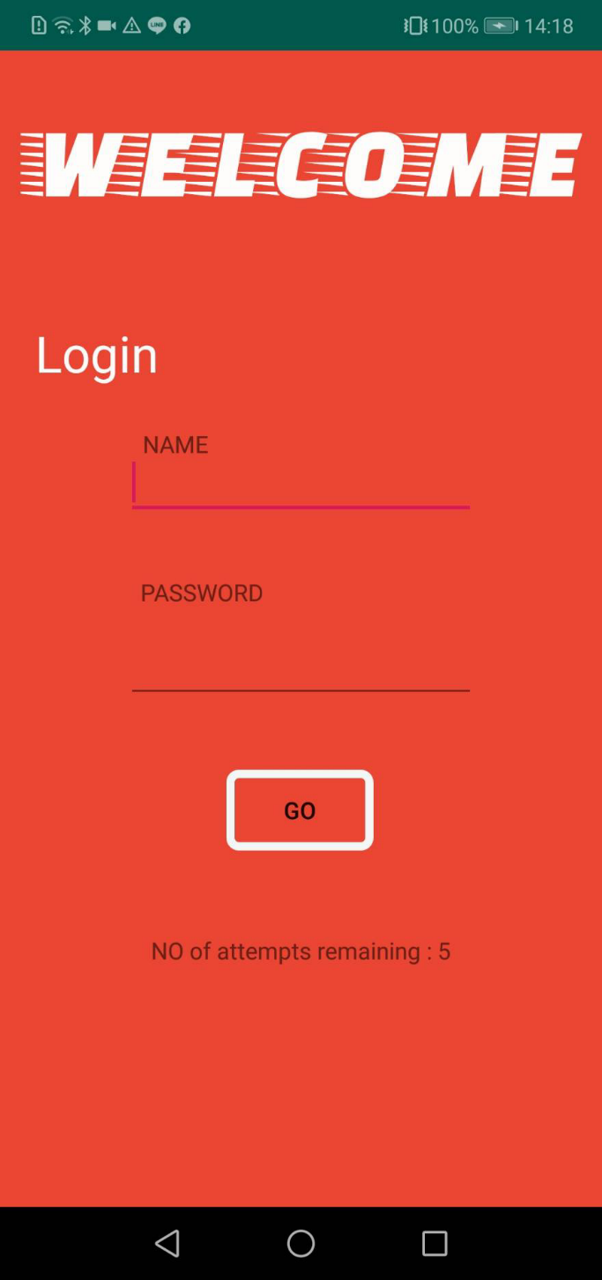
Login Screen
Introduction Android
© group3-gPBL-2020

Slide 14
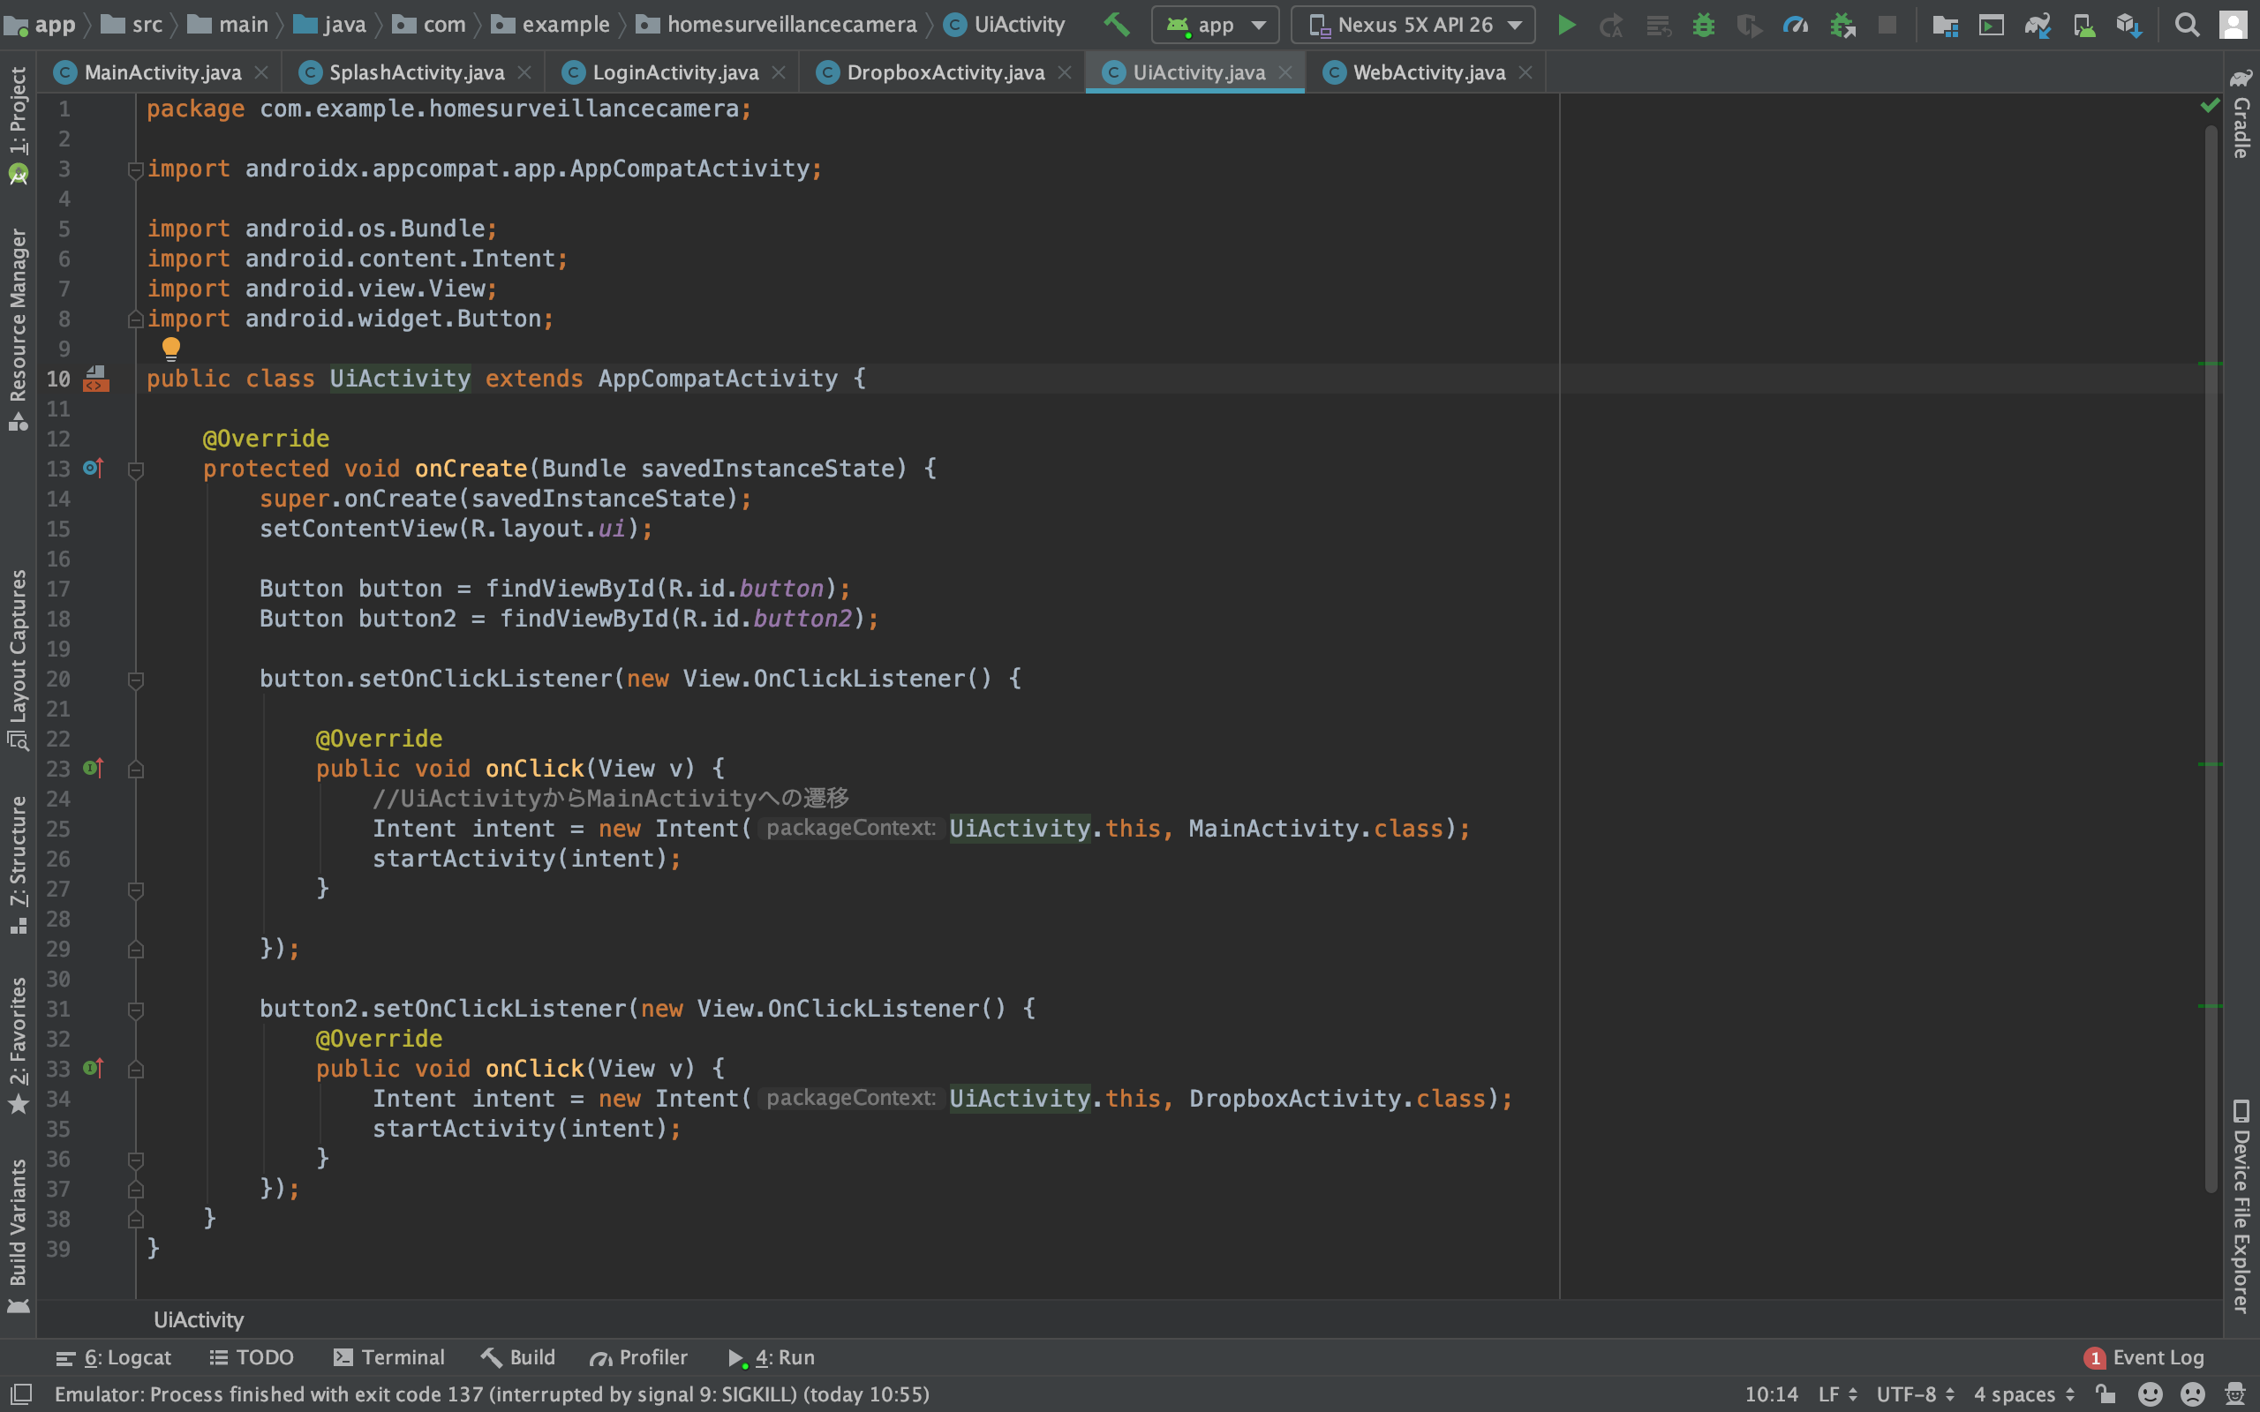
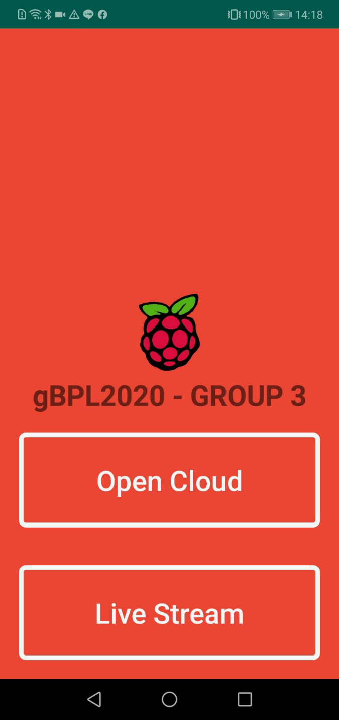
Main Screen
Introduction Android
© group3-gPBL-2020

Slide 15
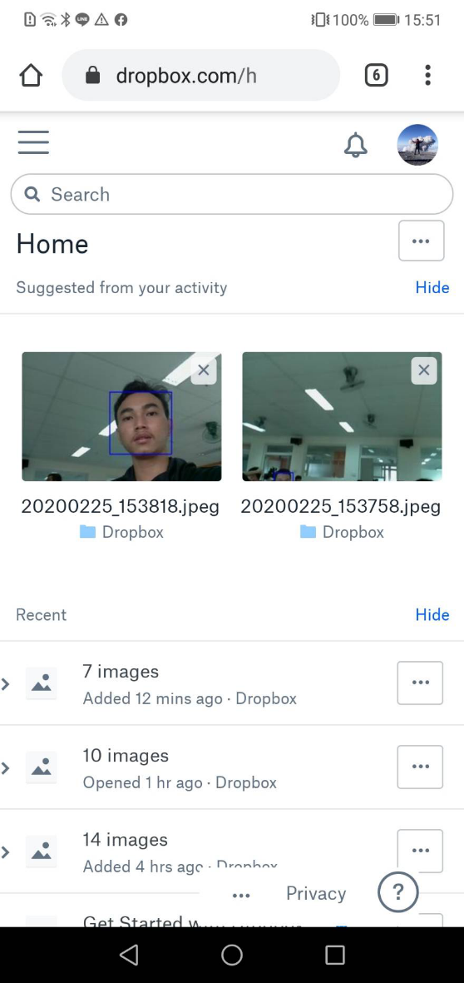
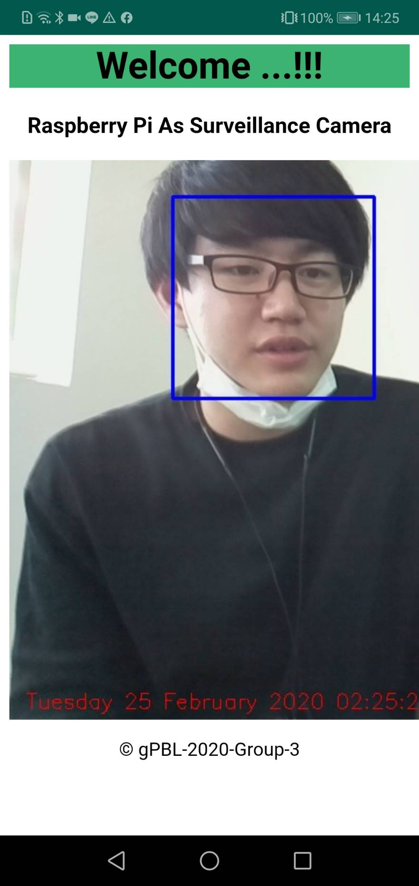
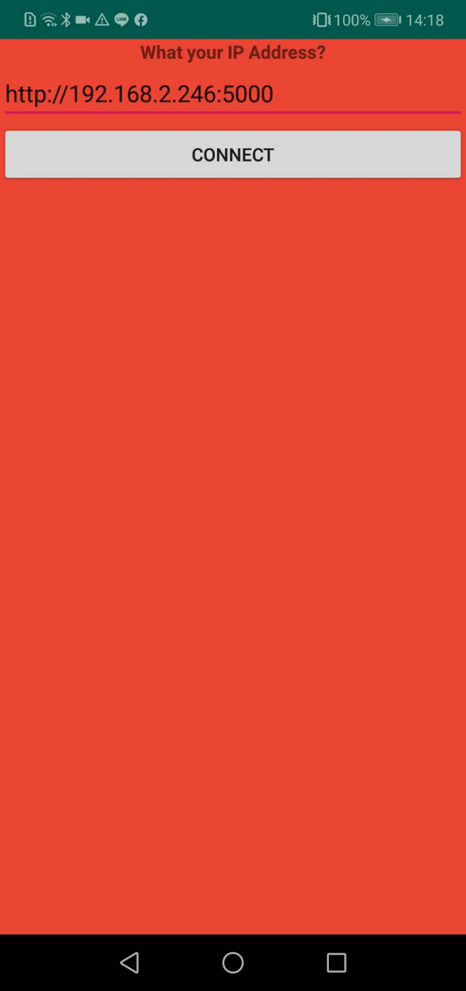
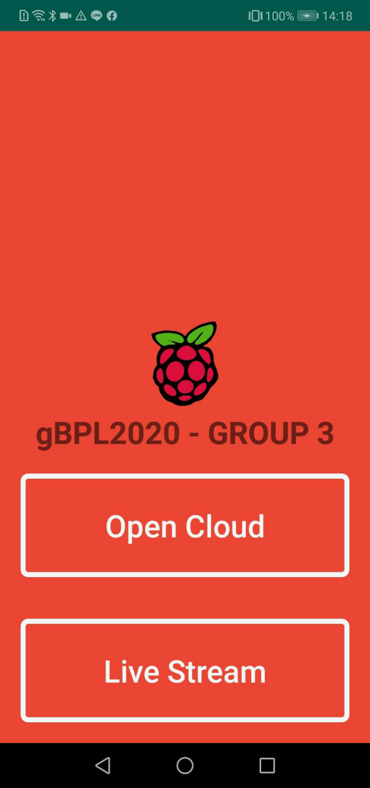
Main Screen
Introduction Android
© group3-gPBL-2020

Slide 16
The Function
Monitoring the condition some place from internet
Always notify when have people come
Serve as evidence when you lose valuable assets
always feel safe when leaving the place
© group3-gPBL-2020

Slide 17
Disadvantage
Using raspberry pi as server, the streaming video is little bit slow
Need connection internet
© group3-gPBL-2020

Slide 18
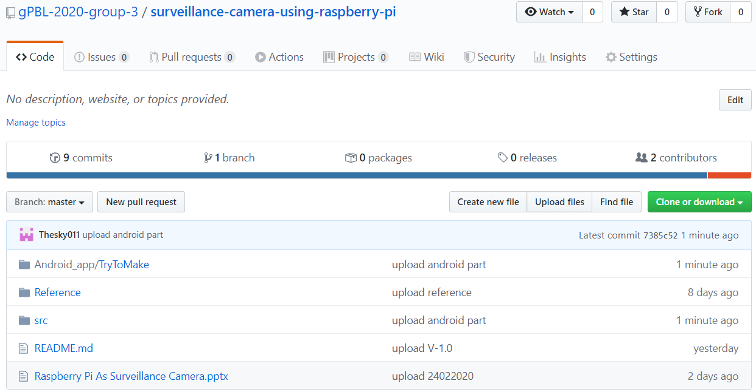
Where you can find this project
https://github.com/gPBL-2020-group-3/surveillance-camera-using-raspberry-pi
© group3-gPBL-2020

Slide 19
Thank You !!!
© group3-gPBL-2020

